Slide 1
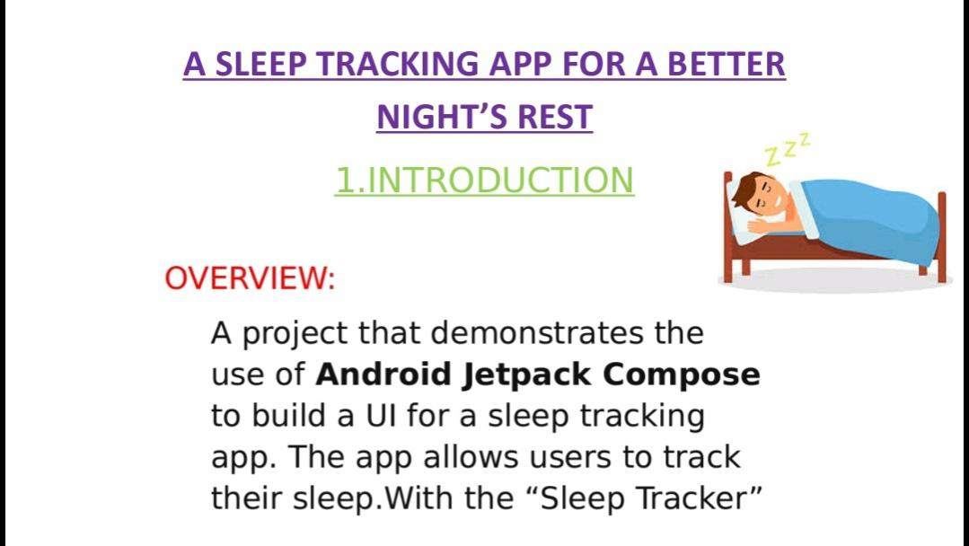

Slide 2
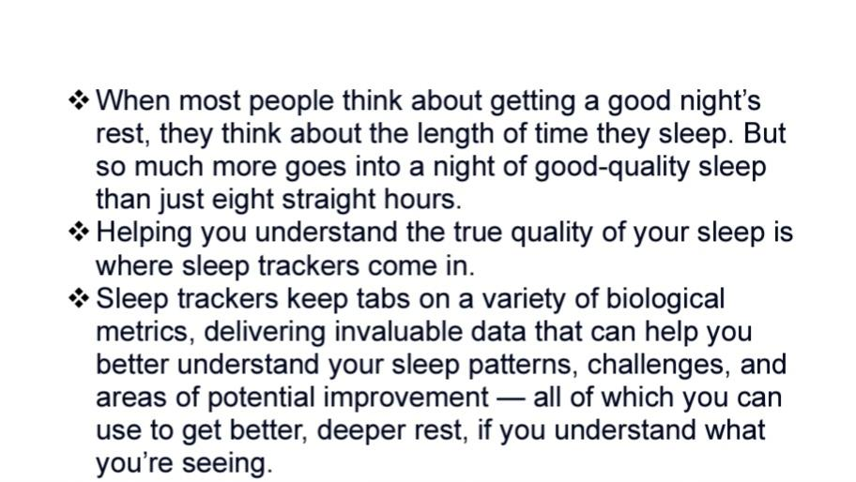
2. Problem definition And design thinking

Slide 3
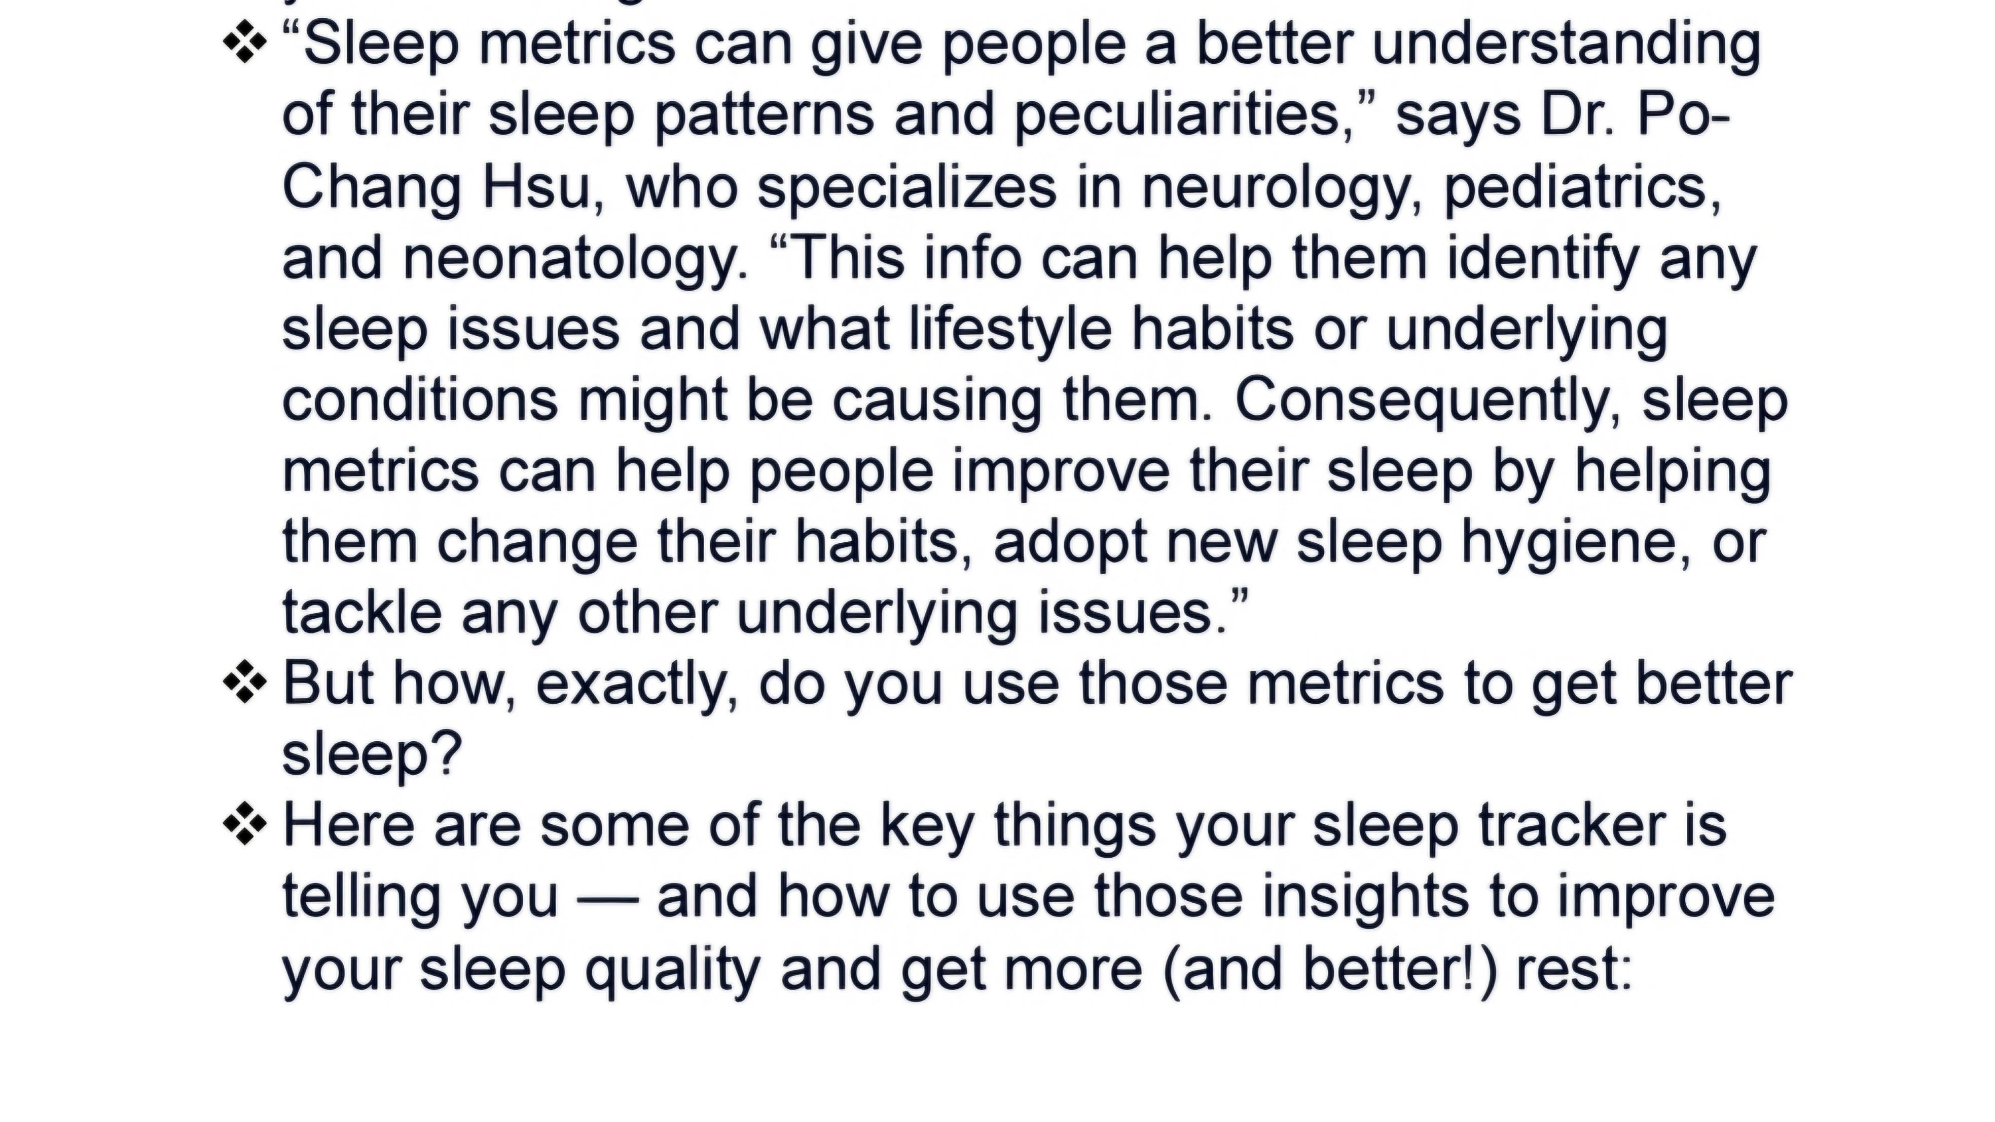

Slide 4
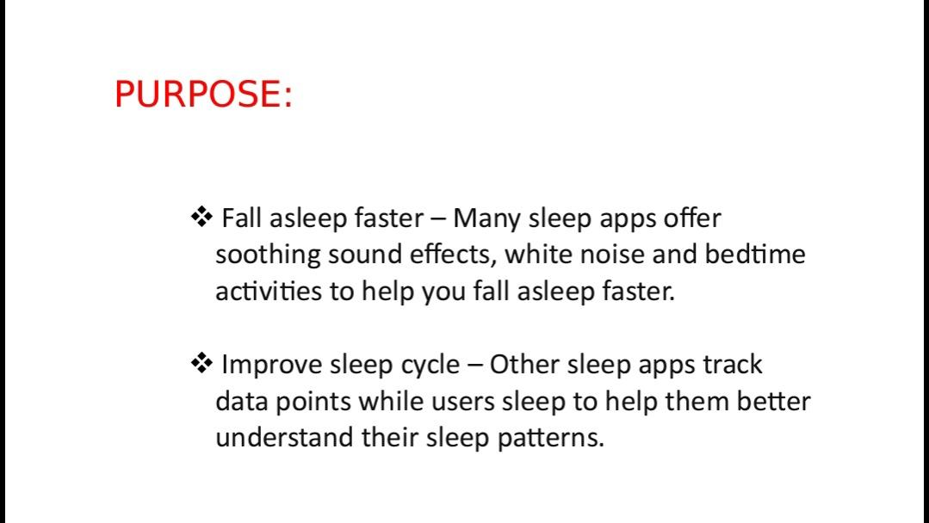

Slide 5
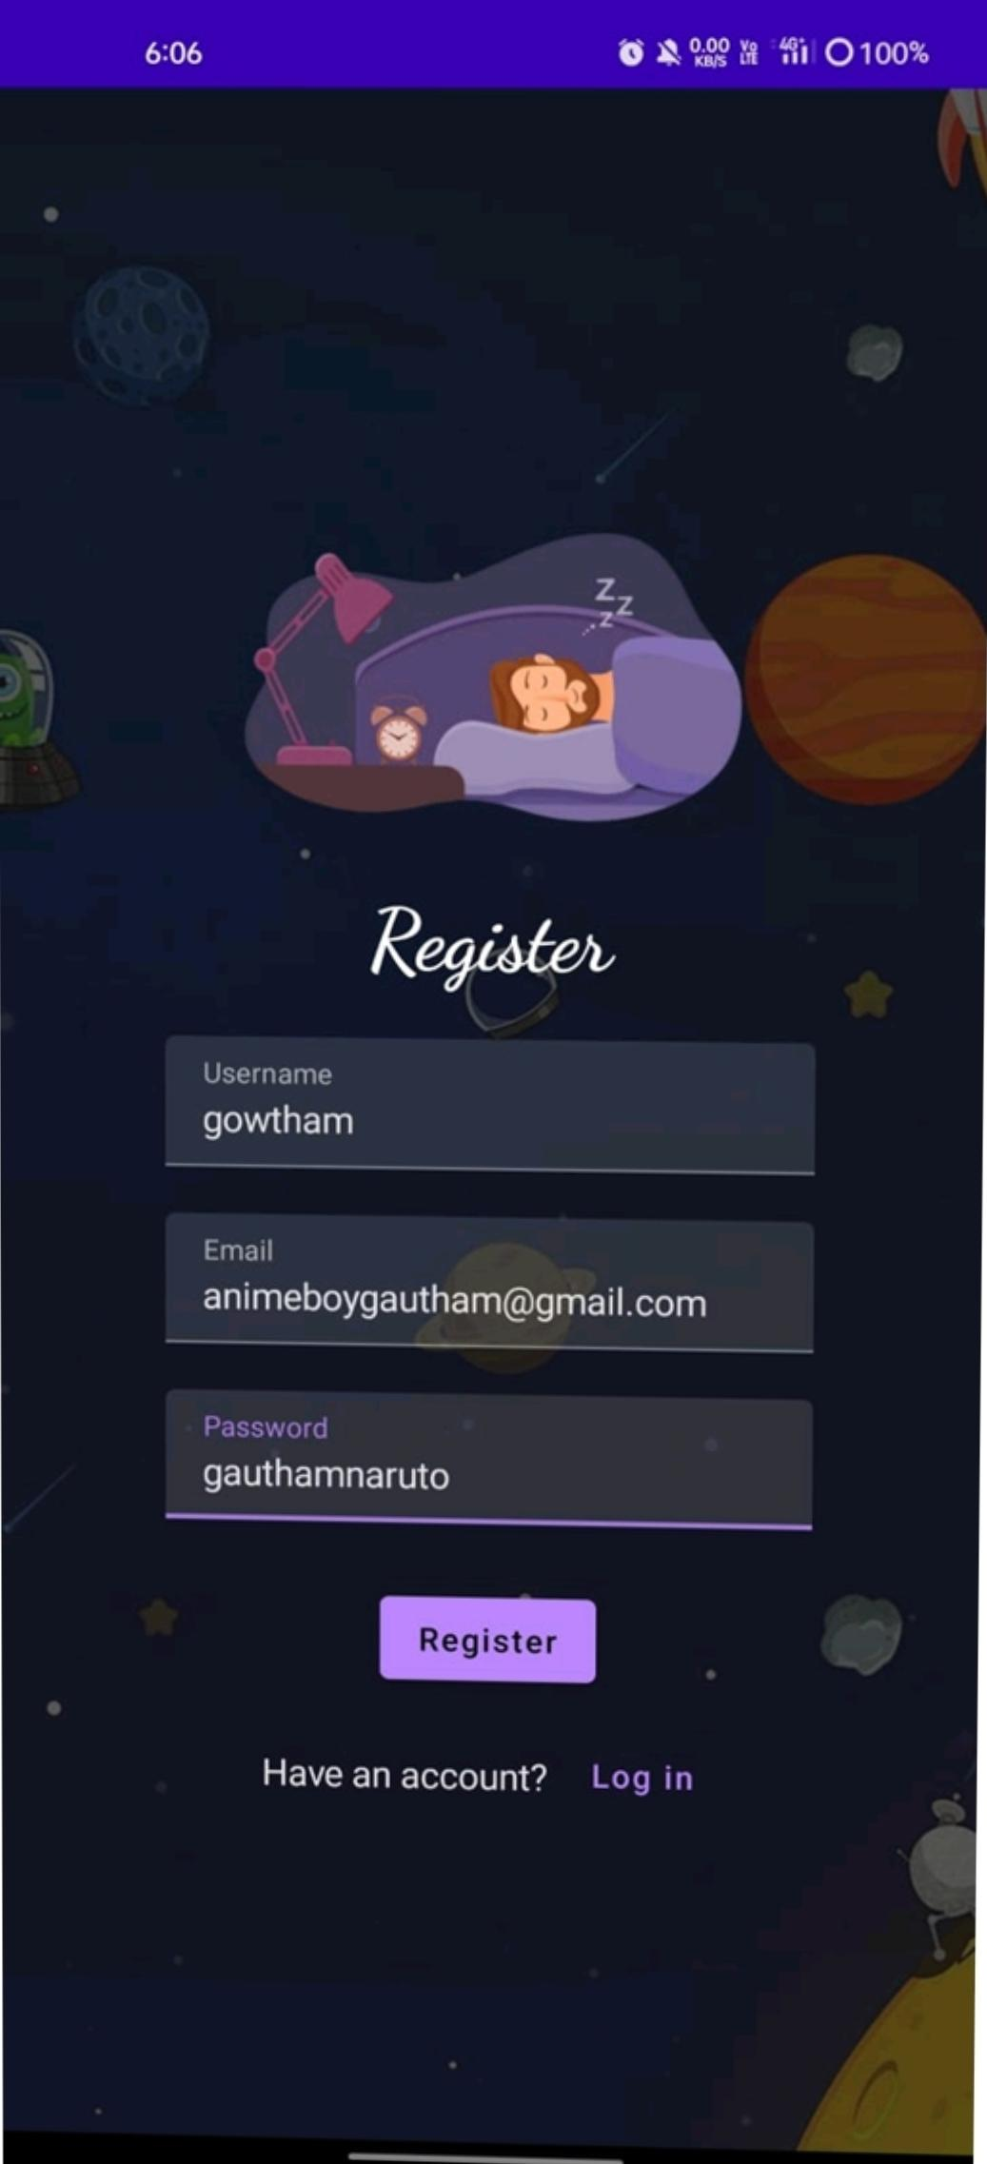
3. Results

Slide 6
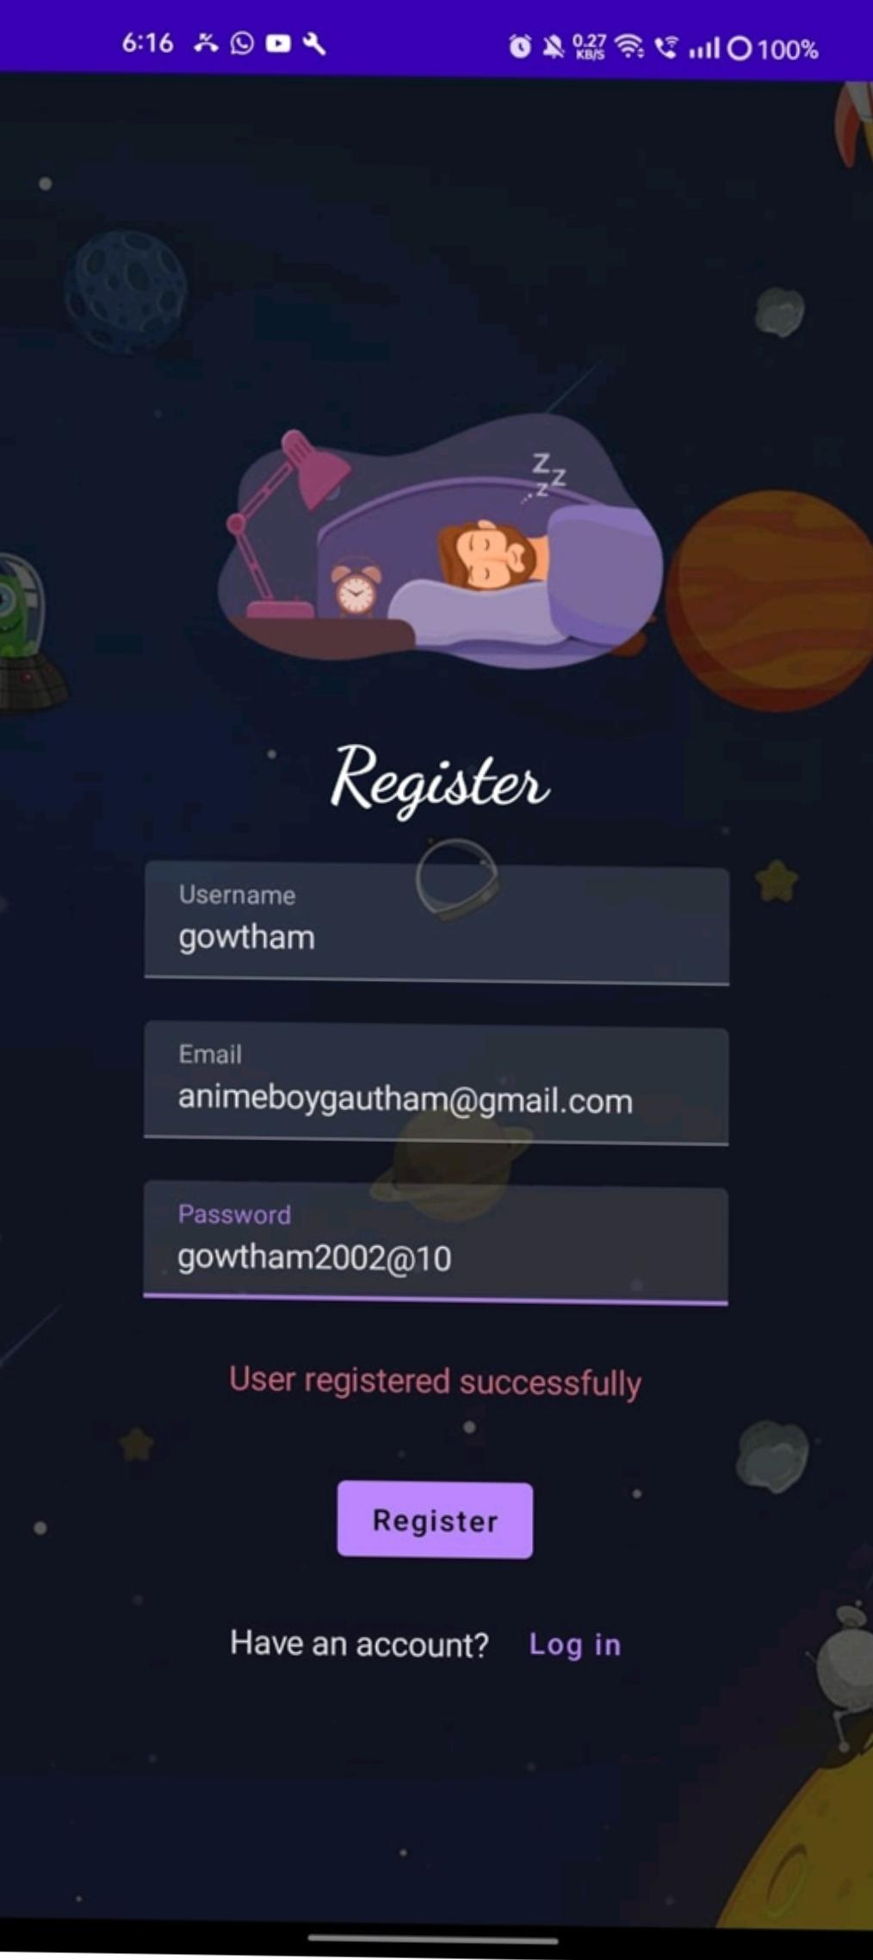
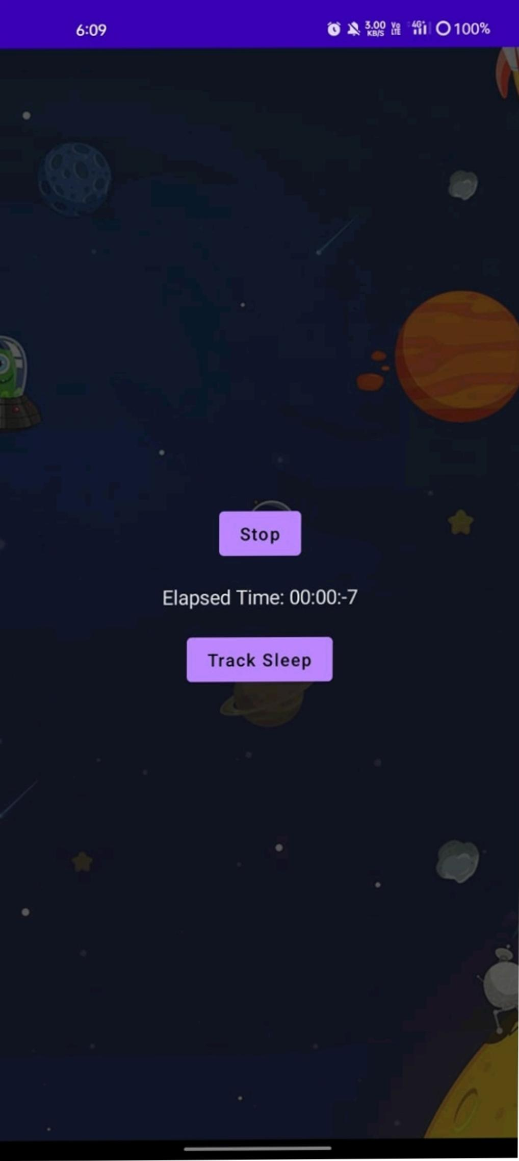

Slide 7
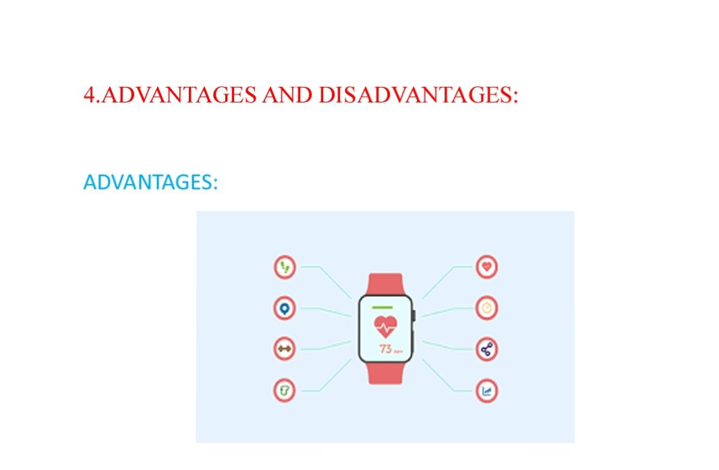

Slide 8
1. Helps You Better Understand Your Sleep Patterns In order to improve your sleep patterns, you need to understand them. ..
2. Tracks Your Different Sleep Phases There are generally four sleep phases: awake, light, deep, and REM. ..
3. Captures Possible Sleep Interruptions and Disruptions …
4. Gently Wakes You Up at the Ideal Time …
5. Convenient Compared to Wearing a Sleep Tracker Device …

Slide 9
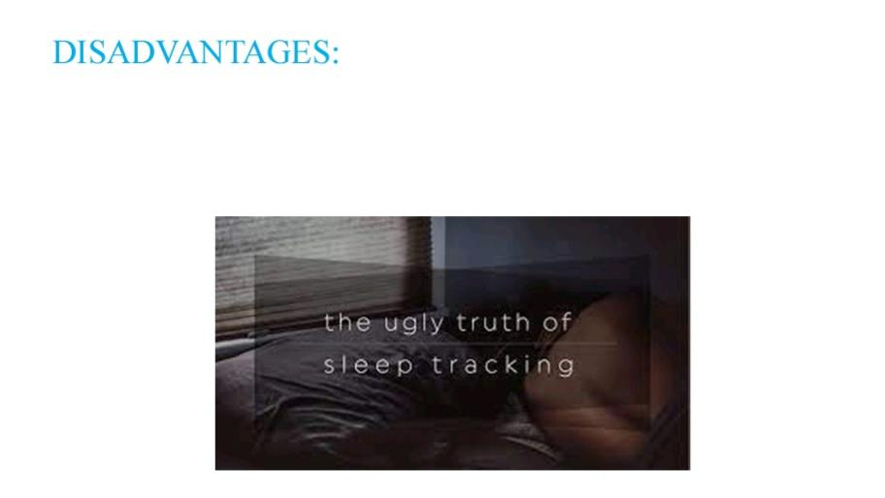

Slide 10
1. Hinders Sleep More Than It Helps Sure, you can use a sleep tracker app to track multiple aspects of your sleep, like your sleep phases, sleep debt, and sleep goals. …
2. Promotes Nighttime Screen Use Before Bed …
3. Incorrect or Unreliable Sleep Tracking Data …
4. Creates an Unhealthy Sleep Obsession …
5. Unable to Track Heart Rate and Movements …

Slide 11
APPLICATIONS
Personal sleep monitoring: Users can track their own sleep patterns, including the duration, quality, and consistency of their sleep. By monitoring their sleep over t ime, users can identify factors that may be affecting their sleep and make changes to improve their sleep quality. Sleep disorder management: People who suffer from sleep disorders such as insomnia or sleep apnea can use the sleep tracking app to monitor their sleep patterns and identify potential triggers or factors that may be exacerbating their condition. They can share the data with their healthcare provider to help with diagnosis and treatment.

Slide 12
Athlete performance tracking: Athletes can use the app to track their sleep quality and duration to optimize their performance. Getting adequate rest is crucial for recovery and athletic performance, and the app can help
Athletes identify areas where they need to improve their sleep habits. Workplace productivity: Employers can encourage their employees to use the app to monitor their sleep and identify factors that may be affecting their productivity. By promoting better sleep habits, employers can improve the health and well-being of their workforce and increase productivity. Sleep research: Sleep researchers can use the app to collect data on sleep patterns and behavior. The app can provide a large dataset of sleep information, which can be used for research and analysis to better understand the science of sleep and its impact on health and wellbeing.

Slide 13
Wellness and lifestyle tracking: People who are interested in wellness and lifestyle improvement can use the app to monitor their sleep habits as part of a larger wellness program. By tracking their sleep, they can identify areas
Where they need to improve and develop healthier habits. Overall, a sleep tracking app for Android can be used in a variety of contexts, from personal health and wellness to scientific research and workplace productivity. The app has the potential to help users achieve a better night’s rest and improve their overall health and well-being.

Slide 14
CONCLUSION
Based on current research, sleep tracking apps can be useful tools for monitoring and improving sleep habits. These apps can provide information about sleep patterns, duration, and quality, as well as offer suggestions for improving sleep hygiene. However, it is important to note that sleep tracking apps may not always be accurate and can sometimes provide misleading information. Additionally, relying solely on technology to improve sleep habits may not be the most

Slide 15
Effective approach, as addressing underlying lifestyle factors such as diet, exercise, and stress management may also be necessary. Overall, if used in conjunction with other lifestyle changes and under the guidance of a healthcare professional, sleep tracking apps can be a useful tool for promoting better sleep and overall health. When choosing a sleep tracking app, it is important to consider factors such as accuracy, ease of use, and privacy policies.

Slide 16
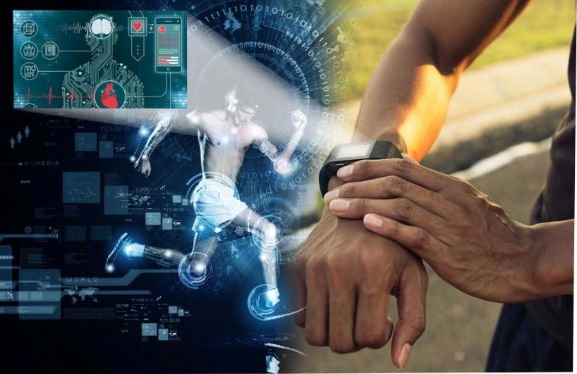
FUTURE SCOPE
The future scope of sleep tracking apps for Android is quite promising. As technology advances, sleep tracking apps are likely to become more accurate and sophisticated, potentially incorporating features such as wearable sensors, machine learning algorithms, and personalized recommendations based on individual sleep patterns and habits.

Slide 17



Slide 18
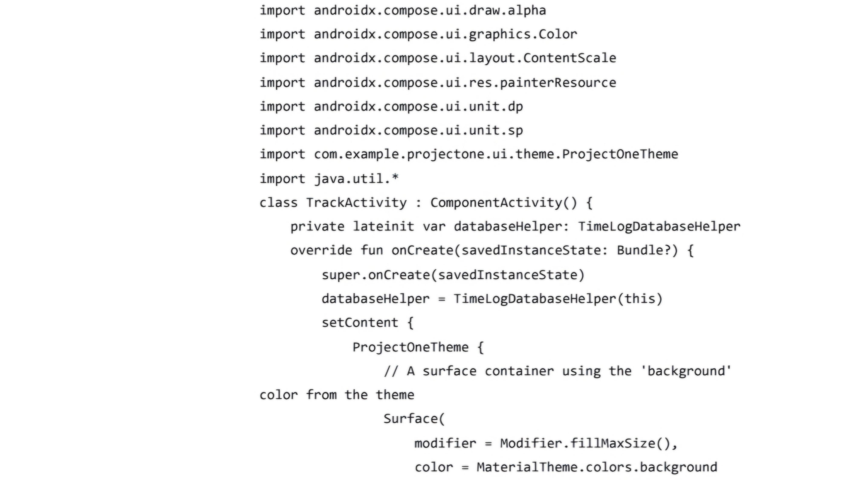

Slide 19


Slide 20


